Slide 1

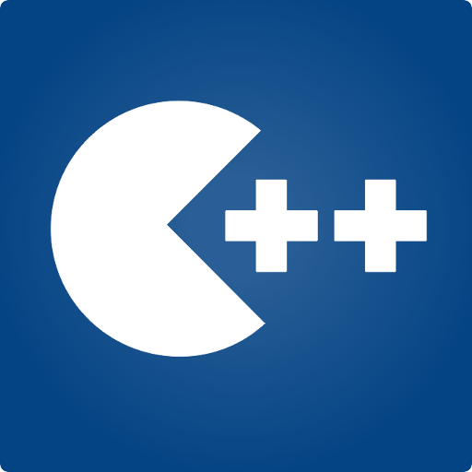
Programming Fundamentals
Taimur Sajjad
MS(Data Science)
Lecturer (Computer Science),,
CUI Wah Campus

Slide 2
What is programming?
Series of instructions to a computer to accomplish a task
Instructions must be written in a way the computer can understand
Programming languages are used to write programs
Once the code (language) of a program has been written, it must be executed (run, started).
You may need to type the name of the program to start it or use a word like RUN and the name of the program (in the old days, anyway).

Slide 3
Program execution
Steps taken by the CPU to run a program (instructions are in machine language):
Fetch an instruction
Decode (interpret) the instruction
Retrieve data, if needed
Execute (perform) actual processing
Store the results, if needed

Slide 4
Language processor

Slide 5
Language Processor
Computer only understands machine language.
Language processor or translator is a software that converts these programs into machine language.
Different types of language processors are as follows:
Compiler
Interpreter
Assembler

Slide 6
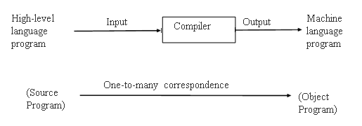
compiler
A compiler is a program that converts the instruction of a high-level language into machine language as a whole.
Compiler also checks syntax errors in the program.

Slide 7
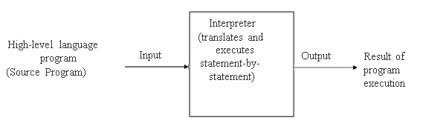
interpreter
An interpreter is a program that converts one statement of a program at one time.
If there is an error in the statements, the interpreter stops working and displays an error message.
The interpreter does not produce an object program.

Slide 8
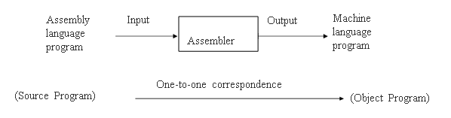
Assembler
An assembler is translating program that translates the instruction of an assembly language into machine language.

Slide 9
linker
Each source program file can be independently modified and compiled to create a corresponding object program file
Linker program (software) is used to properly combine all the object program files (modules)
Creates the final executable program (load module)

Slide 10
loader
In computer systems a loader is the part of an operating system that is responsible for loading programs and libraries.
It is one of the essential stages in the process of starting a program, as it places programs into memory and prepares them for execution.

Slide 11
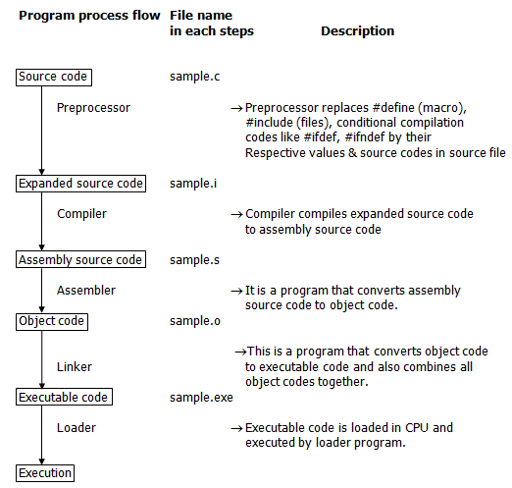

Slide 12
Basic structure of c++ program
The format of writing program in C++ is called its structure.
It consists of the following parts:
Preprocessor directive
Main () function
Program body (C++ statements)

Slide 13
Basic structure of c++ program
Preprocessor directive:
Preprocessor directives are lines included in a program that begin with the character # which make them different from a typical source code text.
They are invoked by the compiler to process some programs before compilation.
These directives are written at the start of program.
2. Main () function:
The function named main is a special function in all C++ programs; it is the function called when the program is run.
The execution of all C++ programs begins with the main function, regardless of where the function is actually located within the code.

Slide 14
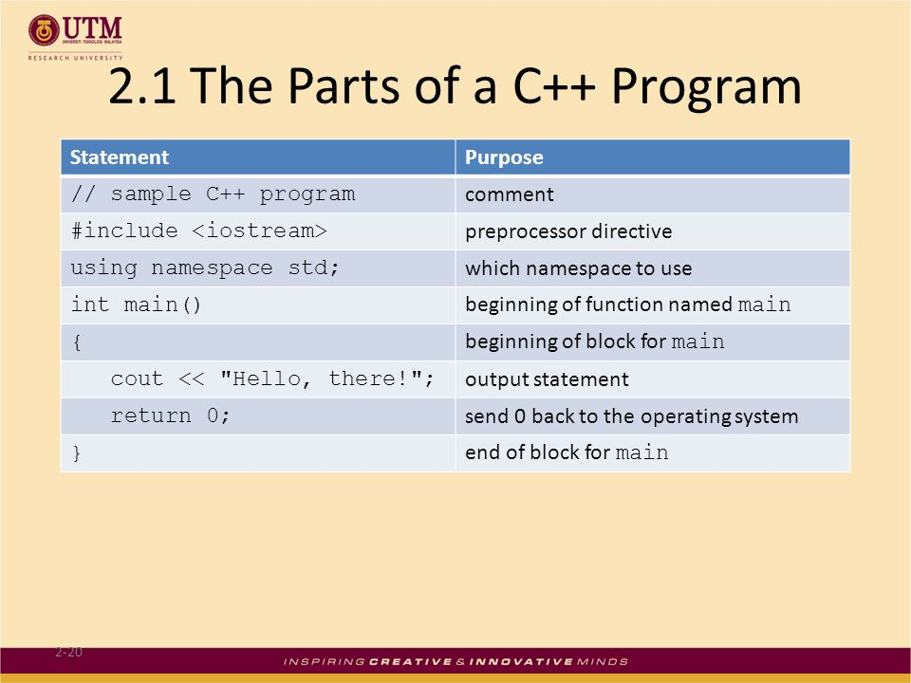
Basic structure of c++ program

Slide 15
Debugging in c++
An error in a computer program is known as bug. The process of finding and removing bugs is known as debugging.
Types of Errors:
Syntax Error : A syntax error is an error in the syntax of a sequence of characters or tokens that is intended to be written in a particular programming language. For compiled languages, syntax errors are detected at compile-time. A program will not compile until all syntax errors are corrected.
Example: Typing cout instead of coutt is an example of syntax error.
cout<<"Hello World";
while the following is not:
coutt<<“Hello World”;

Slide 16
2. Logical Error: A logic error (or logical error) is a mistake in a program's source code that results in incorrect or unexpected behavior. Many different types of programming mistakes can cause logic errors. Example: assigning a value to the wrong variable may cause a series of unexpected program errors.
Such as writing a < 5 instead of a > 5
3. Run-Time Error: A runtime error is a program error that occurs while the program is running. The term is often used in contrast to other types of program errors, such as syntax errors and compile time errors. There are many different types of runtime errors. One example is a logic error, which produces the wrong output.
Example: Dividing a number by zero.

Slide 17

Thank You
Questions ???

